Slide 1
Using Social Marketing to Prevent Heat-related Illness and Improve Productivity among Farmworkers
Paul Monaghan, Maria Morera, Antonio Tovar, Fritz Roka,

Slide 2
Farmworker Association of Florida

Slide 3
Objectives
Explain how social marketing can be utilized as an evidence-based approach to behavior change in agricultural safety settings.
Provide an overview the structures of agricultural work in Florida as they contribute to HRI issues.
Look at the preliminary research findings and where we are going next with our research project.

Slide 4
How do we change behaviors? (from Lee and Kotler, 2016)
1. Technology (often changes behaviors without conscious choice).
2. Science, particularly medical discoveries.
3. Legal, political, policy, enforcement (often appearing after social change movements and advocacy).
4. Schools, churches and families (where we learn most of our culture).
5. Education (including safety curriculums, mandated training and company practices).
6. Media and communications (which have an increasing but largely misunderstood impact on behaviors).

Slide 5
Social marketing makes use of all these influences, while utilizing a unique approach
Focus is on behaviors, researching why individuals currently engage in a particular behavior (or avoid a recommended behavior).
A specific audience is targeted (as marketers do, and by following the evidence from behavioral research).
Exchange theory is critical (as adopters recognize both the barriers to change but also the benefits as they make a choice)
Benefits go to the individual and greater society.
Utilizes all 4Ps- treats behavior like a PRODUCT, it has a PRICE that must be kept low, it must be PLACED where people can use it and PROMOTED in a way that motivates them.

Slide 6
Social marketing is similar (and useful) to many behavior change approaches
Social media. Digital communication channels including Facebook, Twitter, YouTube, blogs, etc.
Non-profit and public sector marketing, from Habitat for Humanity to the US Postal Service.
Nudges and behavioral economics (how to make use of human decision-making patterns)
Social change movements (civil and environmental rights).

Slide 7
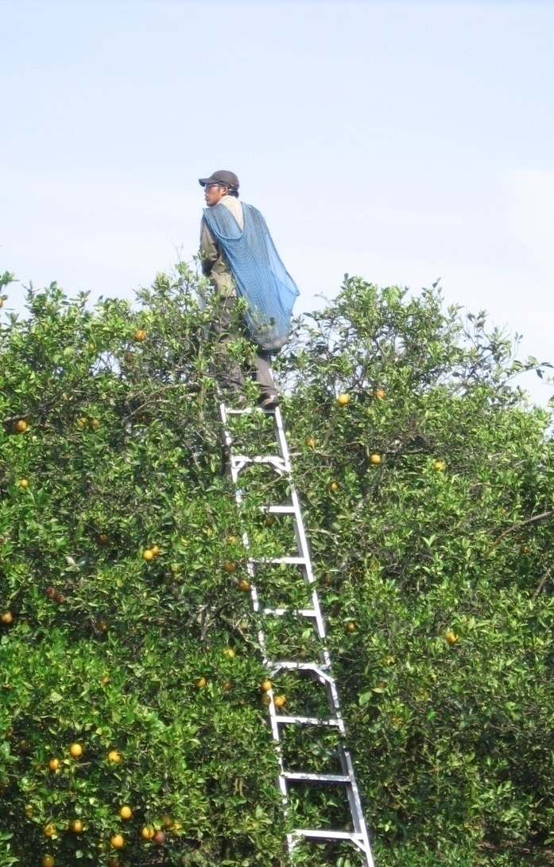
Social marketing applied to adoption of safety glasses

Slide 8
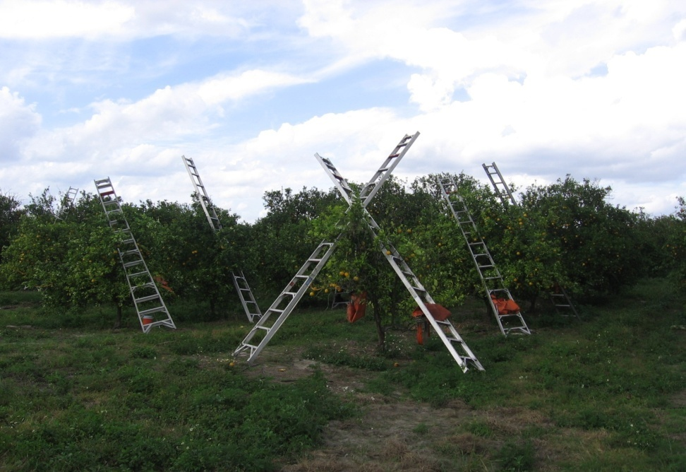
Citrus in Florida
Florida- largest producer of citrus in the United States with half a million acres
95% is harvested by hand
A majority are now H2A contract workers with the remainder migrant and seasonal farm workers, mostly from Mexico

Slide 9
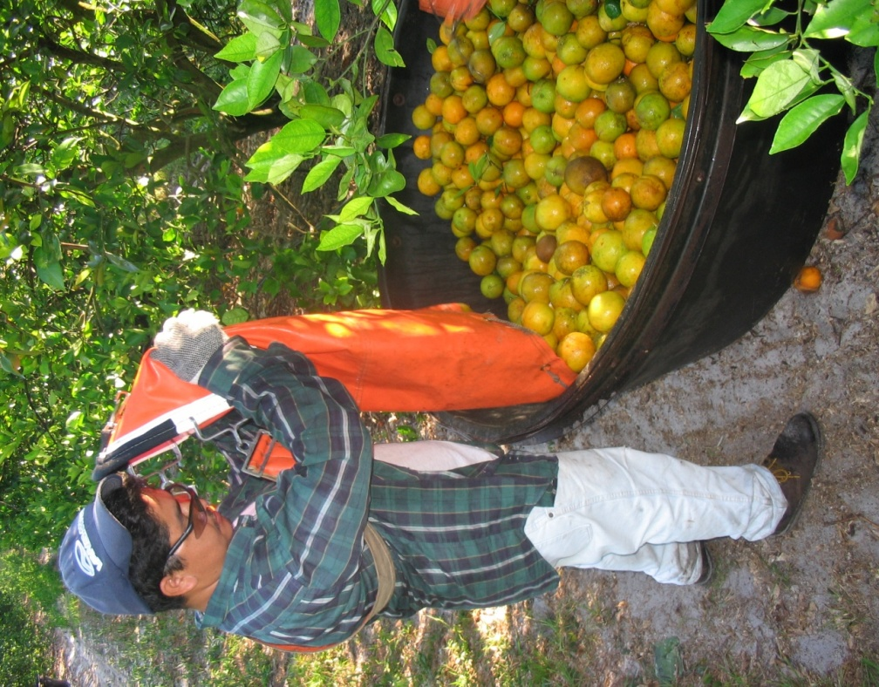
Background on Citrus Harvesting
Harvest done during some of the hottest months of the year (May and June)
18’ ladder with a bag weighing up to 100 lb
Piece rate pay- earnings calculated on a full 900 lb. bin
Good pickers can make $15.00 an hour or more
Field supervisor makes a percentage of the overall harvest by each member of the crew
Workers largely on their own in the field working at their own pace
Notes:
The amount picked depends on the skill of the worker and the quality of the trees and the harvest that year.

Slide 10

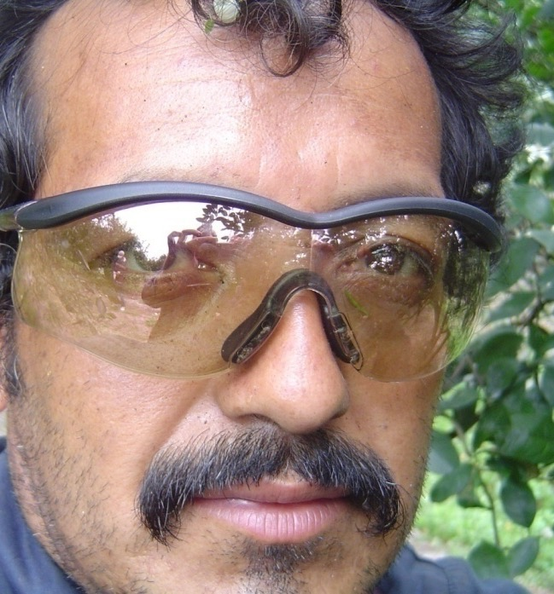
Eye Injuries
Debris, dust, sand, mildew, and fungus from the groves cause the majority of eye irritation and injury cases, sometimes on a daily basis
Branches, leaves and falling fruit cause the most serious and traumatic injuries but they are less common
Most eye injuries self treated and not reported
Safety glasses seen as incompatible with environmental conditions and demands of piece-rate work. They will fog up, making work impossible
Notes:
Survey and focus group research was conducted with citrus workers to reveal the following common eye injuries

Slide 11
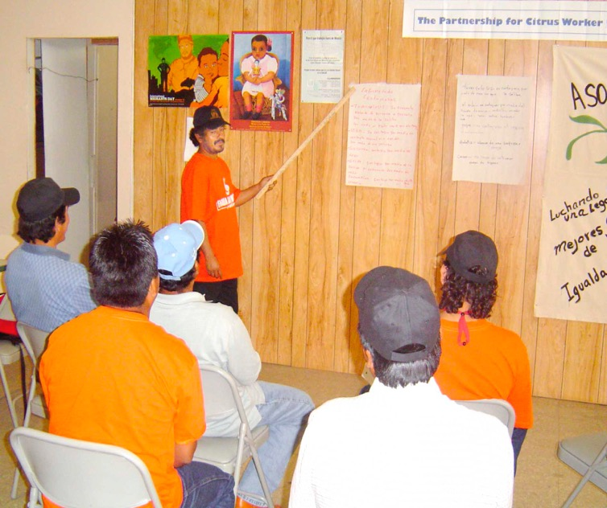
Using community health workers (CHWs) to improve eye safety
Developed over 3 harvesting seasons
Community Health Worker CHW- at the crew level (“eye safety promotor”)
Received 29 hours of training, support and supplies
Educate members of crew
Treat eye injuries in field
Model the behavior by picking while wearing the safety glasses
Notes:
The research team and the community partners decided to test a community health worker model to encourage safety glasses use and provide first aid and education about eye injuries on the job.

Slide 12
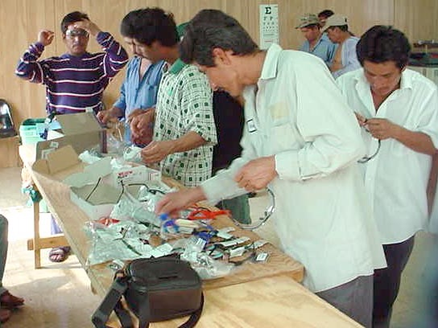
How did social marketing shape the intervention?
Technology, curriculum, teaching, messaging and support all informed by research.
Client centered focus- earning money, staying safe
Included supervisors and companies in the intervention
Barriers to change, including norms
Evaluated for behavior change

Slide 13
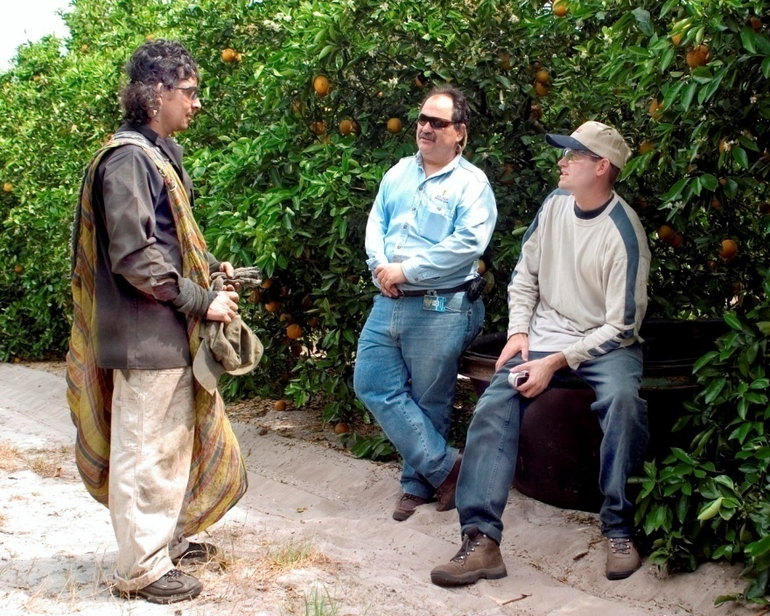
Research results: use of safety glasses by crew level
Control crews
2.4%- First three observations
2.6%- Final three observations
No change over the course of the season
Intervention crews (CHW)
11.1%- baseline observation
27.5%- post intervention observations (avg)
35%- Final observation

Slide 14
Predicted Probability of Adoption of Safety Glasses
Older worker with >1 and <2 years experience who had reported an eye injury and the CHW helped: 69.3%
Older worker with >1 and <2 years experience who had reported an eye injury and no CHW intervention: 43.0%
Youngest worker with 5 years experience and no reported eye injury who the CHW helped: 21.3%
Youngest worker with 5 years experience, no reported eye injury and no intervention: 8.3%
CHW affected the likelihood of safety eyewear use both by their presence and their actions
Age, experience and injury can influence use, suggesting we target specific groups in the future.

Slide 15
Objectives
Explain how social marketing can be utilized as an evidence-based approach to behavior change in agricultural safety settings.
Provide an overview the structures of agricultural work in Florida as they contribute to HRI issues.
Look at the preliminary research findings and where we are going next with our research project.

Slide 16
What can social marketing tell us about preventing HRI?
Research in the workplace describes the barriers to change in addition to the risks workers face.
It also demonstrates the role of “UPSTREAM” decision makers and external forces that shape the workplace and behavior.
It can uncover the attitudes, perceptions and motivations that may encourage behavior change.
It can inform the messages that need to accompany behavior change campaigns to make them more effective.

Slide 17
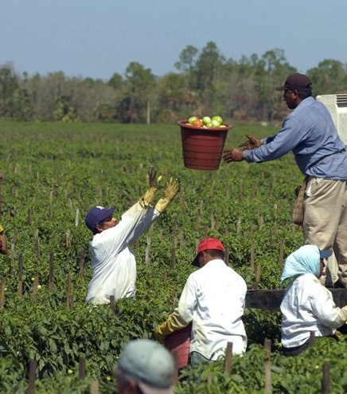
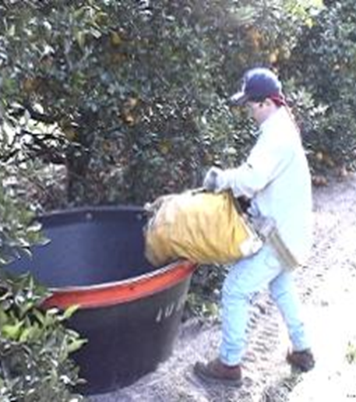
Recruiting and managing labor and keeping workers safe and healthy is key to the success of Florida producers

Slide 18
Labor: the most expensive input
One acre of tomatoes is estimated to require more than 200 labor hours to plant, grow, harvest, and pack for the fresh market.
One acre of citrus harvesting requires between 50 and 60 hours of manual labor.
Florida uses more H2A workers than any other state (18,000 jobs in 2015).
Large contracting companies account for many of the workers and they can shift into different crops.
Estimated ¾ of citrus now harvested by H2A workers.
Recent expansion of strawberries and blueberries is helped by use of H2A.

Slide 19
Why is agricultural work so dangerous?
Physical labor, outdoors, heat and exposure.
Attitudes about risk and safety are culturally determined.
Piece-rate work is fast and does not reward safety
Regulations and enforcement are inadequate to protect workers.
Immigrants face unique hazards (transportation, housing, language, exploitation by crew system).
Rural healthcare has many barriers to immigrants
Outreach and education are very limited.
Employers pay a price for this in turnover, lost productivity and direct costs

Slide 20
What could influence workplace attitudes and policy toward HRI?
Changes in laws and policies to recognize the risk of heat in the workplace (CA and WA already have them, there is a bill proposed for the Florida legislature).
Tightening labor markets and increased cost of H2A workers (ag worker retention becomes critical)
Changes in corporate social responsibility (social compliance audits)
Shared values (everyone wants a safer workplace).

Slide 22
Objectives
Explain how social marketing can be utilized as an evidence-based approach to behavior change in agricultural safety settings.
Provide an overview the structures of agricultural work in Florida as they contribute to HRI issues.
Look at the preliminary research findings and where we are going next with our research project.

Slide 23
The complexities of preventing HRI
Prevention starts with acclimatization weeks before.
Preparation starts the day before (transportation home, evening routine, housing conditions).
The morning routine (pre-hydration, breakfast, packing needed tools for HRI safety).
The phases of work during the day- transportation to the fields, timeclock, breaks, getting back on the bus- each presents opportunities for hydration and HRI awareness.
Food safety regulations may hinder some HRI strategies
Risks are also specific to the crop being harvested.

Slide 24
Crews and crew leaders
Ag work organized into crews of 10-30 people
Independent farm labor contractors (FLC) are licensed by DOL and Florida Department of Business and Professional Regulations
If the labor supervisor is directly employed by the farm they do not need FLC license yet may perform all of the same functions.
Mobility of contractors may provide workers more work between different regions.
Growers are provided large numbers of workers only when they are needed
Size of operation can make a big difference
Type of crop can make a difference
Main influence in workplace for improved safety culture

Slide 25
Farm Labor Supervisors
Primarily male, 40+ years old, with many years experience as FLS (10+).
Almost half have experience as farmworker or grew up in a crew leader family.
Spanish is primary language. But many found to prefer training in English.
Formal education is low.
Majority migrate out of Florida at the end of the season.
More than 300 have been trained in regulations, field sanitation, WPS, driving & basic personnel management (trafficking, discrimination) by the University of Florida Institute for Food and Agricultural Sciences
HRI curriculum recently added to annual training

Slide 26
Training needs
Minimal testing required to obtain a license.
Only California requires training beyond the initial test.
Before 2010, most training in Florida limited to grower sponsored workshops.
Growers are primarily concerned about their crew leaders following regulations (housing, wage and hour, transportation) because of fines.
There are regional differences around the state such as who transports workers (or if they provide their own transportation) and who provides housing
Increase of H2A workers adds to regulatory complexity
Curriculum choices and opportunities for HRI prevention are limited

Slide 27
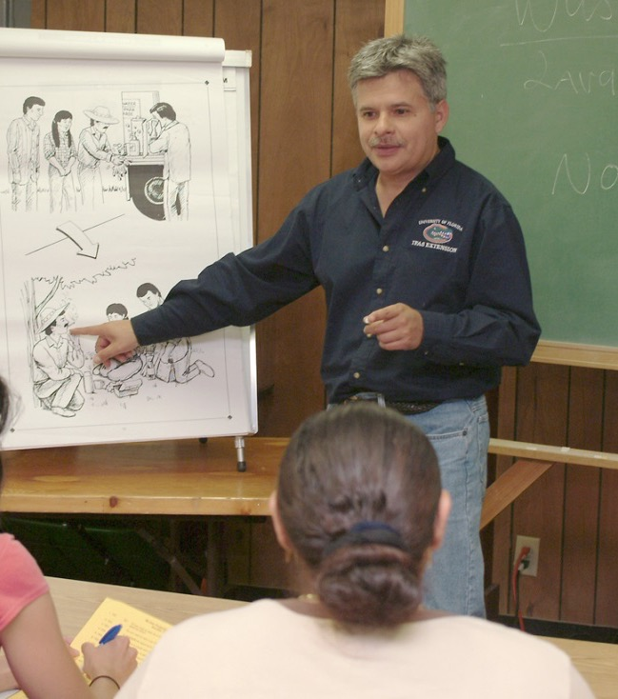
Is voluntary training enough?
Growers averse to mandated training
FLS see it as a way to level the playing field & professionalize industry
With tightening labor markets, work conditions will become bigger factor.
Safety in the fields depends on the FLS

Slide 28
Research design for social marketing and productivity study
3 crews of 30 workers, each getting different treatment; standard company HRI training, additional FLS training, enhanced HRI campaign for crew using social marketing.
Hydration measured before and after work, on 3 consecutive days
Productivity (pounds harvested) measured for all 3 treatments
Repeated in cool season (November-December) and warm season (April-June)
Outcomes: if hydration can be improved, its relation to productivity can be established. Implications for workers, FLS and employers

Slide 29
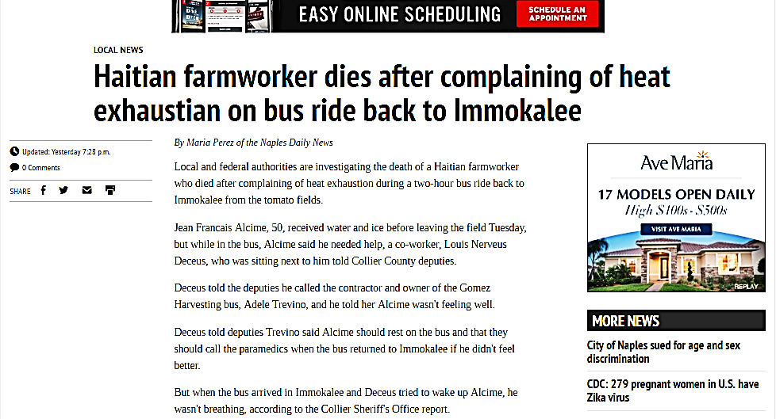
Farm labor supervisors play a key role in HRI safety:

Slide 30
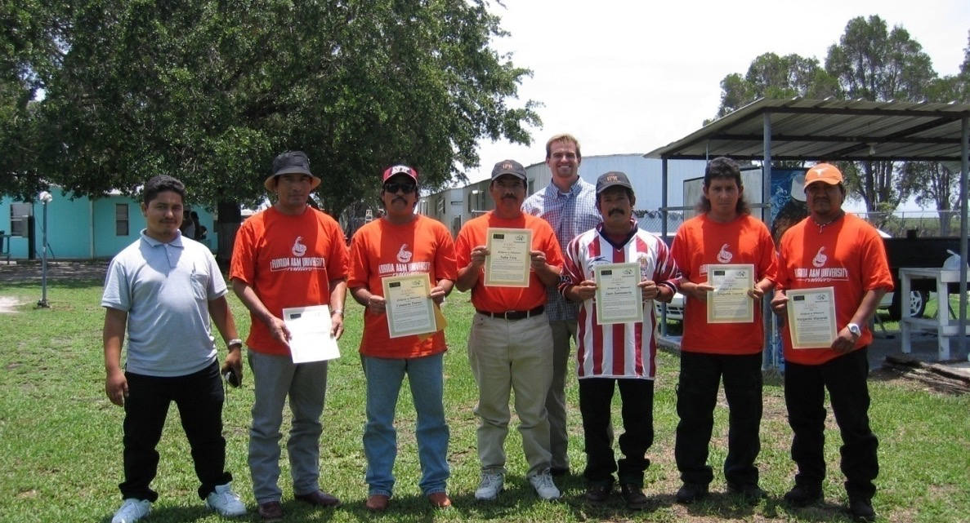
Thank you

