Slide 1
Psychological First Aid for building resilience
Lynn M. Grattan, Ph.D.
Professor of Neurology, Psychiatry, Epidemiology and Public Health
University of Maryland School of Medicine

Slide 2
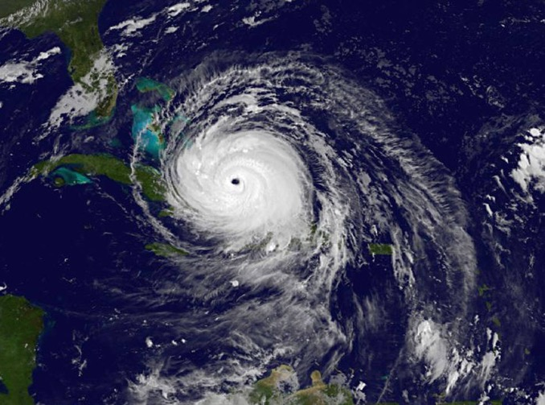
WHY HERE? WHY NOW?
FIRST RESPONDERS
HURRICANE IRMA
Service capacity
Build your resources to help others
Prevent hurricane related traumatic stress reactions.
Encourage resilience

Slide 3
WHAT IS TRAUMA?
Events or experiences that are shocking and overwhelming, typically involving threat to the physical, emotional, or psychological safety and well-being of the individual victim(s), loved ones, friends or others.
Military combat, acts of terror, motor vehicle and other accidents, natural or human caused disasters, sexual and emotional abuse, and many other causes.
The occurrence is usually sudden and unexpected.
The impact/duration of the stressors may be short term or long term.

Slide 4
SYMPTOMS OF TRAUMATIC STRESS
Recurrent, involuntary, intrusive recollections of the event
Avoidance of stimuli associated with the trauma
Negative alterations in cognition or moods; numbing (or both) associated with the event
Heightened arousal and reactivity to the event including heightened sensitivity to potential threat

Slide 5
Many of these reactions are normal

Slide 6
stop the maintenance and persistence of stress symptoms
Build resilience

Slide 7

What is Resilience?
The qualities that enable an individual to thrive despite adversity
Protective against the development of long term mental health problems
Power for recovery

Slide 8
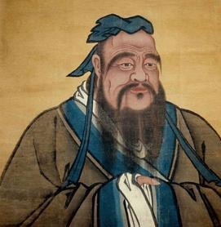
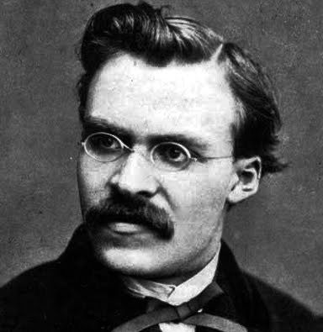
“Our greatest glory is not in never falling,
but in rising every time we fall”
(Confuscius)
“That which does not kill us can only
make us stronger”
(Nietzsche)

Slide 9
The theory outpaces the science

Slide 10
WHAT WE DO KNOW
BEHAVIORAL REACTIVITY AND ADJUSTMENT

Slide 11
Normal and Expected Reactions
After hurricane disaster, there is an increase in distress in community members and Early Responders.
Managing practical concerns are the most significant stressors: shelter, food, water, power, finances, health, farms, livestock, citrus groves, work.
25% to 40% “Disaster Syndrome”
30% Symptoms of Anxiety, Depression one month post-hurricane.
11% t0 40% Symptoms of Anxiety, Depression six months to 27 months.
Delayed onset of symptoms is common
First Responders: High risk for Burnout.

Slide 12
TROUBLESOME
Need Self Care
Medical Assistance
Sleep difficulty*
Tired all of the time
Decreased frustration tolerance
Hyper arousal*
Difficulty concentrating
Loss of interest
Increase in smoking
Occupational burnout as a result of prolonged period of stress (personal and workplace).
Sig. increase in alcohol use
Increase in domestic violence
Suicidal thoughts, plans, attempts
Homicidal intent
Panic attacks

Slide 13
coping

Slide 14
1. PROBLEM FOCUSED COPING
Strategies to directly remove or reduce the cause of the stressors
Information seeking
Obtaining practical assistance (housing, food, water, money…..)
Connecting with others to enlist help (family, friends, coworkers, supervisor)
Outline a Plan
Evaluate pros and cons
Time management
Maintain Focus

Slide 15
2. EMOTION FOCUSED COPING
Strategies to reduces the negative emotional responses (fear, anxiety, sadness) when the stressor is beyond the persons control
Venting, sharing thoughts feelings with another person, connectedness
Prayer for guidance and strength, hope, calming
Journaling (gratitude diary)
Personal reflection (flower, thorn, bud)
Meditation; Taking a Moment (mindfulness)
Cognitive reappraisal (look at things a different way)
Medication
Eating (comfort food)

Slide 16
3. DISENGAGEMENT
Focuses on avoidance of negative emotions
Distraction: keep yourself busy to take your mind off of the situation
Suppressing negative thoughts or emotions
Alcohol
Illicit drug use
Social isolation

Slide 17
RESILIENCE/RECOVERY
Facilitate Recovery
Barriers to Recovery
Social support/connectedness
Confidence in one’s ability to manage this stressor based upon based experiences
Problem focused coping
Adaptability
Optimism/hope
Stressors are persistent and overwhelm the capacity of the individual to respond over time.
Disengagement coping
Alcohol/Drug Abuse
Negative rumination
Cognitive rigidity

Slide 18
Do’s & don’ts

Slide 19
For You: Do
Make contact with others, share stories
Engage in positive distracting activities (sports, hobbies, reading)
Get adequate rest, eat healthy meals
Try to maintain a normal schedule
Schedule pleasant activities
Focus on something practical you can do now to manage the situation
Exercise in moderation
Use relaxation methods (breathing exercises, medidation, calming self-talk, soothing music

Slide 20
For You: What doesn’t help
Wait until you are so stressed an exhausted that you cannot benefit from talking with someone else
Use alcohol or non- prescription drugs to cope
Engage in violence or conflict
Overeat or fail to eat
Blaming others, anger, bitterness
Working too much
Extreme withdrawal from family, friends, co-workers
Doing risky things (driving recklessly, substance abuses, not adequate precautions)
Excessive TV or computer games

Slide 21
WORKING WITH OTHERS….Do
Listen to their experience
Help them to establish a sense of safety
Help with practical concerns
Help them establish a sense of connection with yourself and others
Encourage them to face stresses one at a time, one day at a time and respect their way of coping
Be a calming presence
Help establish a sense of hope, optimism via “baby steps.” Remind them they have risen before.

Slide 22
TAKING CARE OF OTHERS…Don’t
Ask them if they are ok (instead: how are things going?)
Tell them they will be ok (instead: express belief that everyone is capable of recovery, most people are resilient and can bounce back)
Make false promises or tell them things will return to “normal.” (Instead: there will be a “new normal.”)
Minimize their distress (show compassion, empathy)

Slide 23


