Slide 1


Heat Stress and Biomarkers of Renal Disease SCCAHS Webinar Series
Linda McCauley, RN, PhD, FAAN, FAAOHN
Dean and Professor
Nell Hodgson Woodruff School of Nursing
Emory University
February 12, 2019

Slide 2
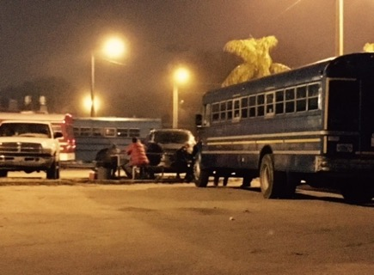
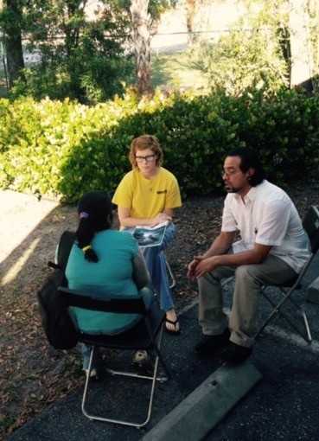
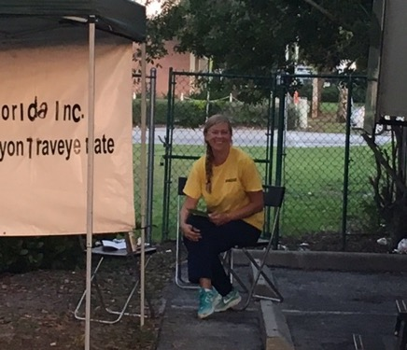
The Girasoles (Sunflower) Study
Center for Disease Control and Prevention | National Institute for Occupational Safety and Health
2014-18
R01-OH01657-01

Slide 3
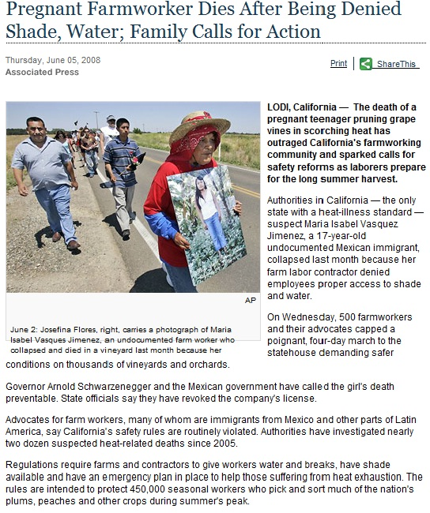
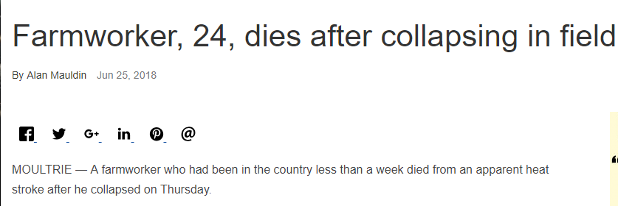
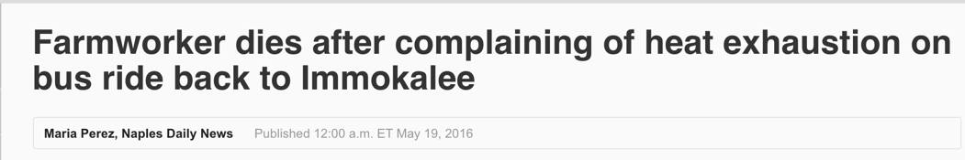
Occupational Heat Stress
The Moultrie Observer
Naples Daily News

Slide 4
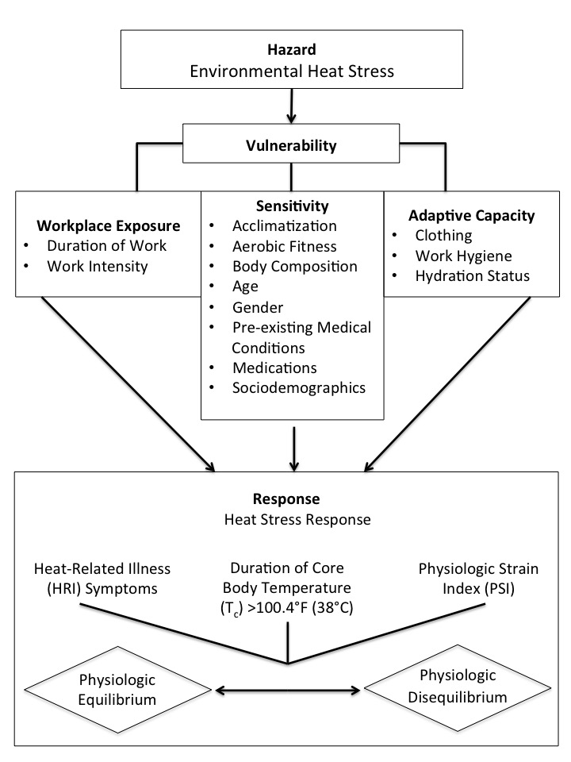
Farmworker Vulnerability to Heat Hazards Framework
Hazard
Vulnerability factors:
Workplace exposure
Sensitivity (non-modifiable)
Adaptive capacity (modifiable)
3. Heat Stress Response
Notes:
framework

Slide 5
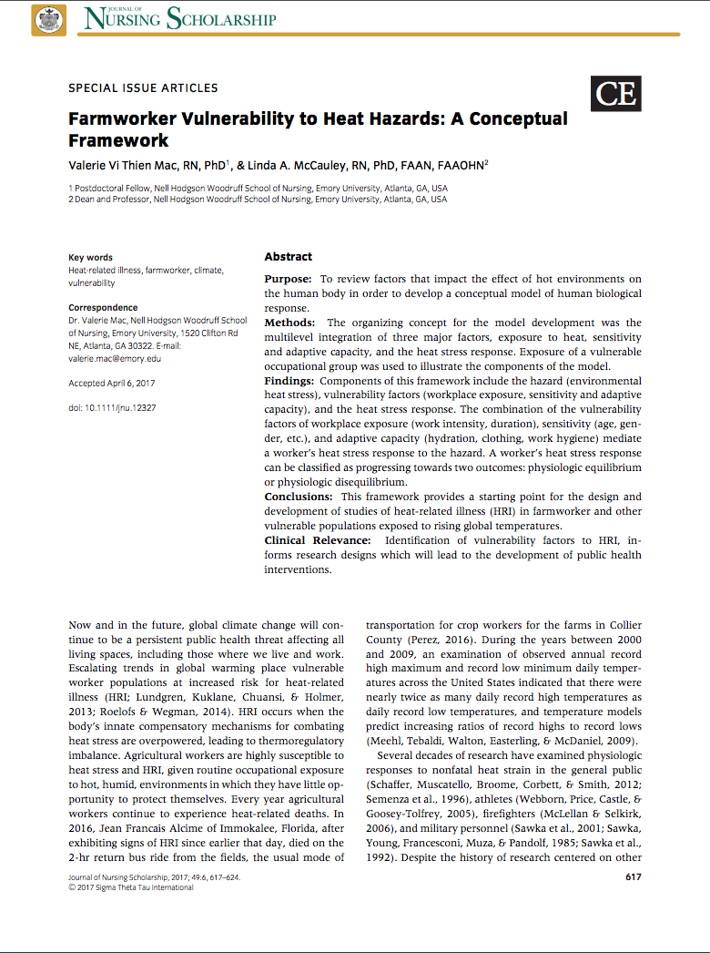
Mac, Valerie Vi Thien, and Linda A. McCauley. "Farmworker vulnerability to heat hazards: a conceptual framework." Journal of nursing scholarship 49.6 (2017): 617-624.

Slide 6
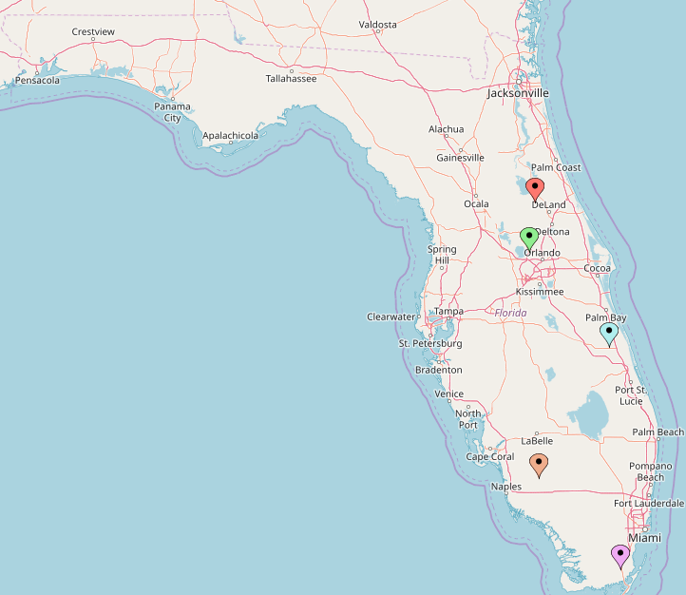

5 Girasoles Study Recruitment Locations in Florida
Pierson
Apopka
Fellsmere
Immokalee
Homestead

Slide 7

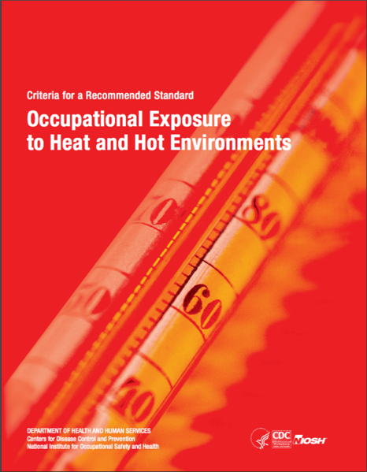
Recommended Core Body Temperature Limits
38.0°C (100.4°F) – For workers not acclimatized or medically cleared.
38.5°C (101.3°F) – For workers acclimatized, medically screened and monitored. Worker core body temperature should never exceed this level.
Notes:
ACGIH sets limits that a healthy worker can be repeatedly exposed without adverse health effects

Slide 8
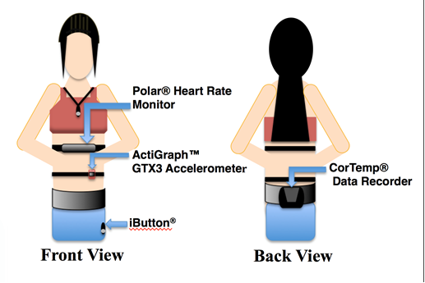
3 Workdays of Biomonitoring + Surveys
Baseline, Pre-Workday and Post-Workday
Biological Samples:
Urine Specific Gravity
Blood osmolality/Blood chemistry
Survey:
Heat-related Illness Symptoms
Demographics

Slide 9
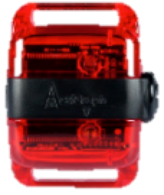
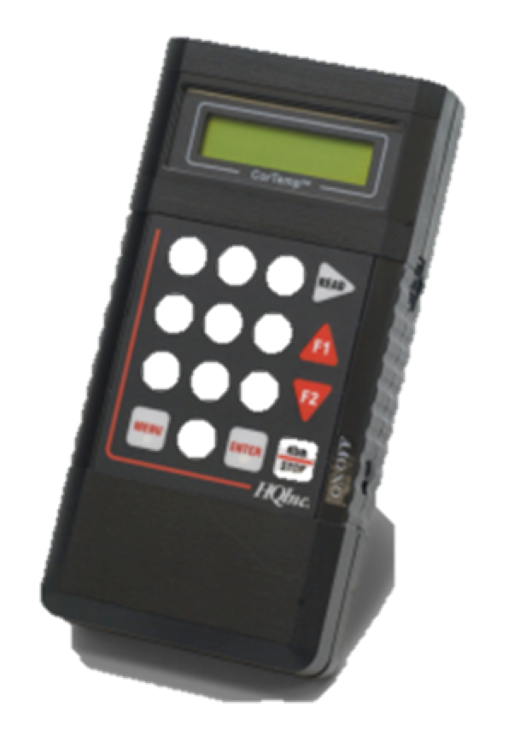

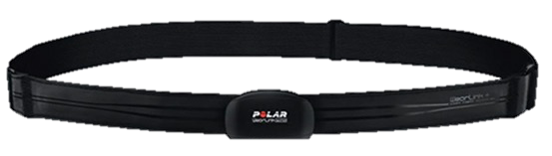
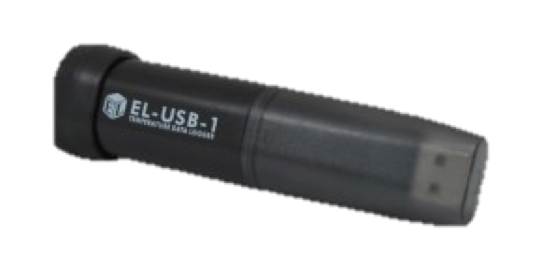
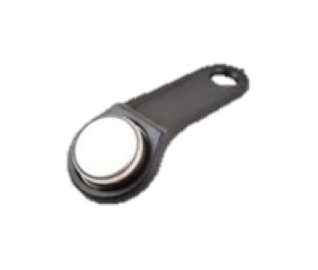
Comprehensive Heat Stress Monitoring
Actigraph Accelerometer records physical activity in three planes of motion
CorTemp® monitor records the internal temperatures from the pill
Heart rate monitor measures heart beats during work
Home monitor records the overnight temperatures from the home
iButton records the temperature and humidity at your workplace
Notes:
Carried over monitors from pilot to track activity, core temperature, and heart rate during the workday
Added devices:
to monitor temperatures in the home- to assess “recovery” conditions
and to monitor microenvironment of each farmworker in the workplace- to assess more precise heat exposure, accounting for shade cloths, trees, UV radiation, etc.

Slide 10
Results

Slide 11
Study Participant Characteristics n = 248
Mean Age: 38 years (SD± 9)
Female: 62%
Years in U.S. Agriculture: 12 years (SD± 8)
Country of Origin: Mexico (66%), Guatemala (15%), Haiti (10%), Other (7%) , U.S. (2%)
Work Type: Crops (31%), Fernery (26%) and Nursery (41%)

Slide 12


Environmental Heat
Fawn Data:
Regional Weather Network Data every 15 minutes
Mean Heat Index: 90°F ±6
iButton Data
Immokalee (n=66) and Apopka (n=39)
284 Observation days
Worksite-based data every 15 minutes = 10,000 readings
Mean Heat Index: 105°F ± 9.2
Mac VV, Hertzberg V, McCauley LA. Examining Agricultural Workplace Micro and Macroclimate Data Using Decision Tree Analysis to Determine Heat Illness Risk. Journal of Occupational and Environmental Medicine, in press, October 2018 .

Slide 13
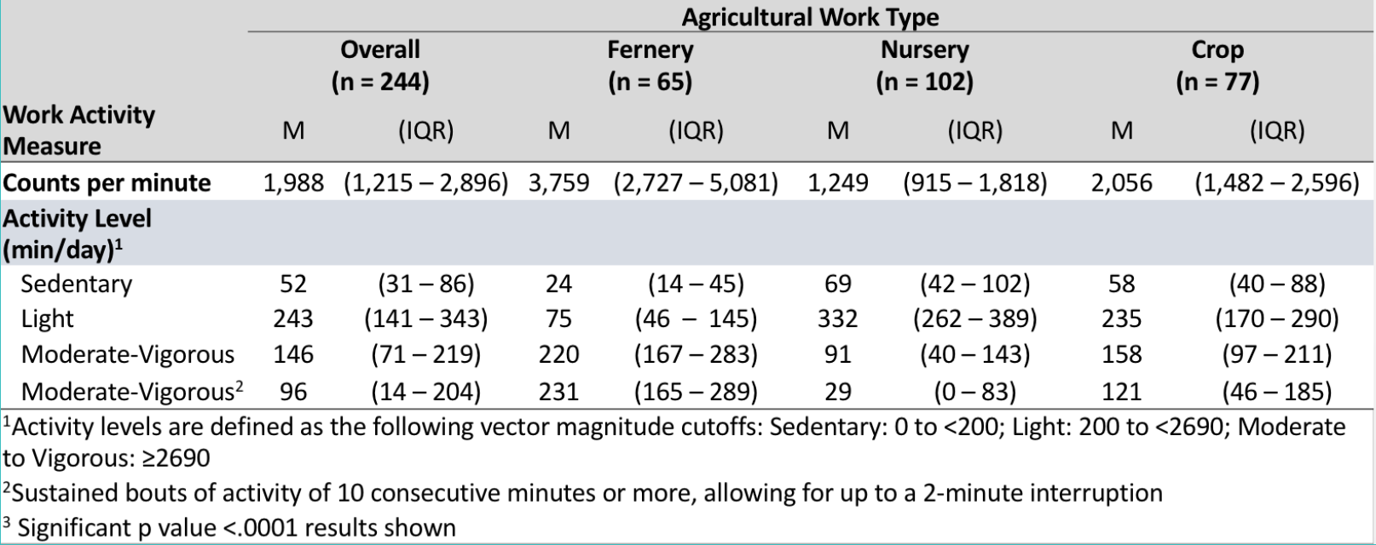
Activity Measures from Accelerometer Data
Notes:
Paper under revision at American Journal of Industrial Medicine

Slide 14
Proportion of Day Spent in Activity Levels
Notes:
Paper under revision at American Journal of Industrial Medicine

Slide 15
Activity Pattern Over the Workday
Notes:
This plot shows the overall pattern of physical activity over the work day by primary agricultural type (fernery, field crop, nursery)
Vector magnitude (VM3): a composite activity count measure incorporating all three planes of motion, which is output by the accelerometer
Median values were used as data were skewed
Functional data analysis (FDA) was used to examine activity patterns over the work day by agricultural work type; differences in curves were determined using an omnibus test

Slide 16
Hydration Status
Urine samples collected before work and after work from each participant
Urine Specific Gravity (USG): measurement widely used to measure hydration status in the field setting
Values range from 1.000 (pure water) to 1.050 (maximum concentration capacity of renal system
USG was categorized into
USG ≥ 1.020: hypohydration threshold
USG ≥ 1.030: clinical indicator for severe dehydration
Notes:
Pre-shift and post-shift USG values were categorized into values ≥ 1.020 or <1.020, based upon the hypohydration threshold guideline of the American College of Sports Medicine (27). USG values > 1.030 were considered to represent severe clinical dehydration (24, 28).

Slide 17
USG measures before and after work
Plots display USG measures for n = 248 workers, over 549 workdays

Slide 18
Hydration Status (n =248, 549 workdays)
Biomarker | Before Work¹ | After Work¹ | p value²
USG, mean ± SE | 1.020 ± 0.0004 | 1.024 ± 0.0004 | <.0001
USG ≥ 1.020 | 53% | 81% | <.0001
USG > 1.030 | 3% | 13% | <.0001
¹n participants for day 1 was n = 248 , day 2 was n = 243, and day 3 was n = 228
²adjusted for random effects due to multiple participants in households and multiple days per participant
Notes:
Will update with full sample

Slide 19
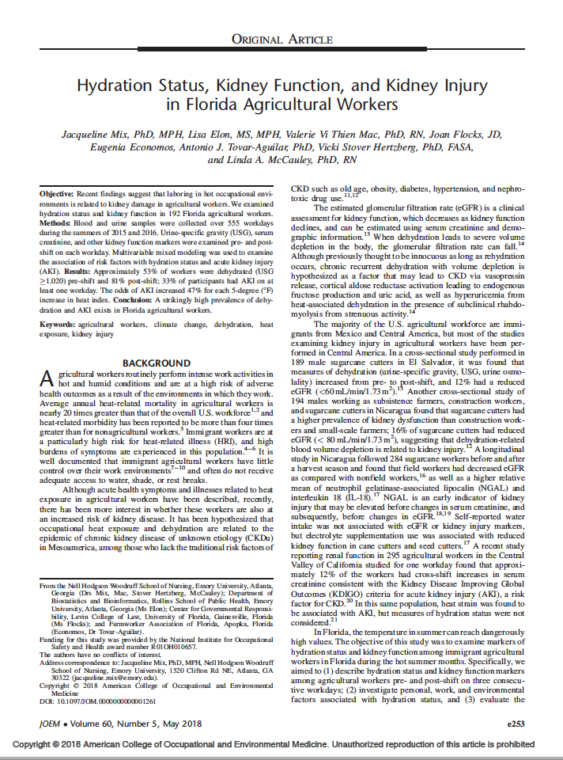
Mix, J., Elon, L., Vi Thien Mac, V., Flocks, J., Economos, E., Tovar-Aguilar, A.J., Stover Hertzberg, V. and McCauley, L.A., 2018. Hydration Status, Kidney Function, and Kidney Injury in Florida Agricultural Workers. Journal of occupational and environmental medicine, 60(5), pp.e253-e260.

Slide 20
Heat Related Illness Symptoms
On the post-work survey, workers reported HRI symptoms experienced during their workday:
Excessive sweating
Headache
Dizziness
Nausea/Vomiting
Muscle Cramps
Confusion
Fainting
84.3% of workers reported at least one symptom, 42.3% reported two or more symptoms, and 18.6% reported three or more

Slide 21
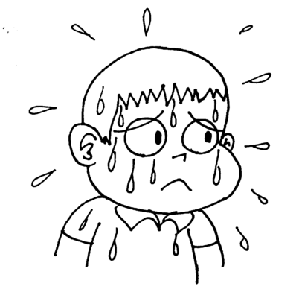

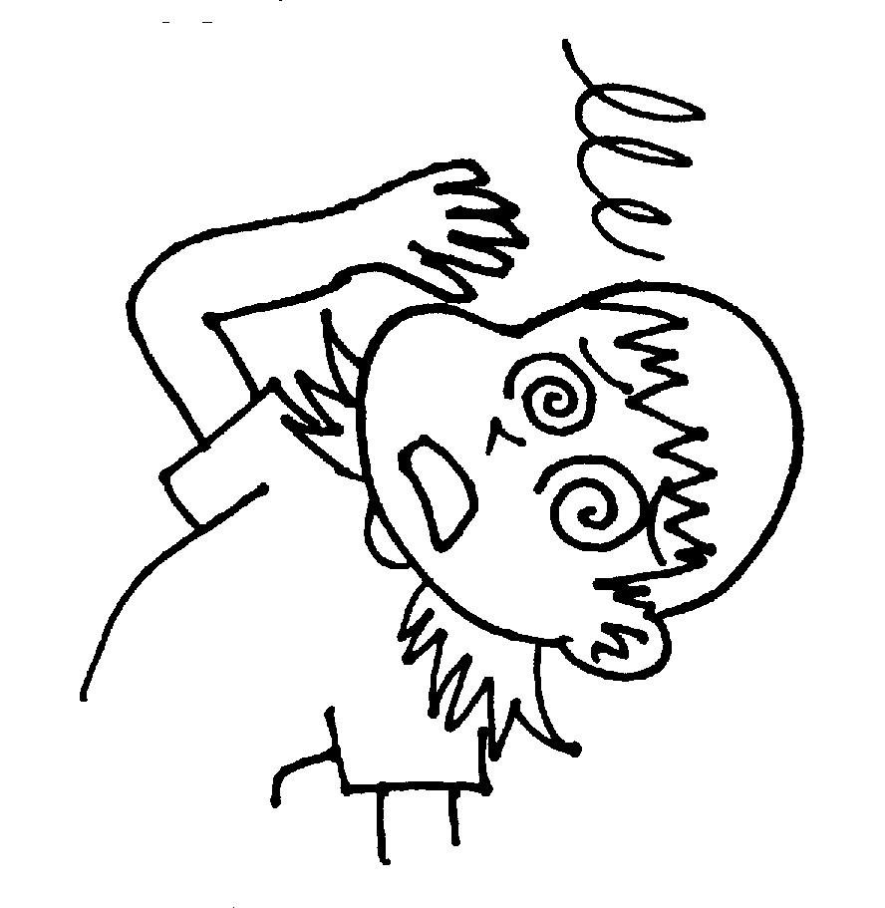
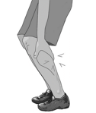


Heat-Related Illness Symptoms During Work
Notes:
These results reflect the symptoms reported during the work week.
These were summarized if the participant “ever reported” this symptom on at least one of their workdays.

Slide 22
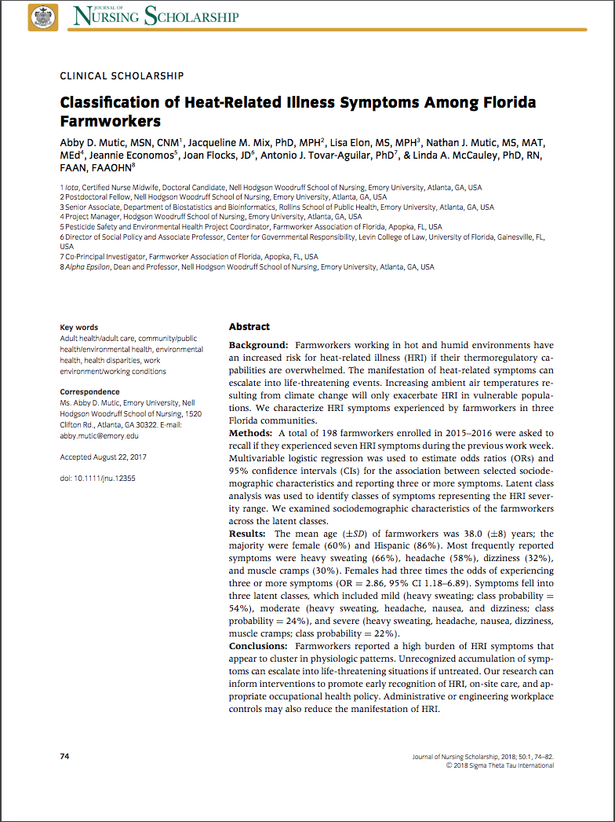
Mutic, A.D., Mix, J.M., Elon, L., Mutic, N.J., Economos, J., Flocks, J., Tovar‐Aguilar, A.J. and McCauley, L.A., 2018. Classification of Heat‐Related Illness Symptoms Among Florida Farmworkers. Journal of nursing scholarship, 50(1), pp.74-82.
Notes:
Ask Abby for infographic about symptom clustering?

Slide 23
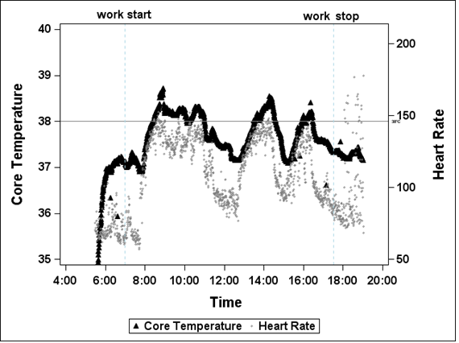
Body Temperature & Heart Rate in One Worker
Recorded every 30 seconds
2 consecutive readings over 38.0C or 38.5C considered exceeding physiologic limit threshold
Temperature or Heart Rate file removed if >20% of data points missing
Notes:
Core body temperature and heart rate data from one person’s workday
For this analysis, the outcome was whether or not the core body temperature exceeded the recommended limits or not.
We removed physiologically implausible values but did not apply smoothing measures to the data prior to analysis.

Slide 24
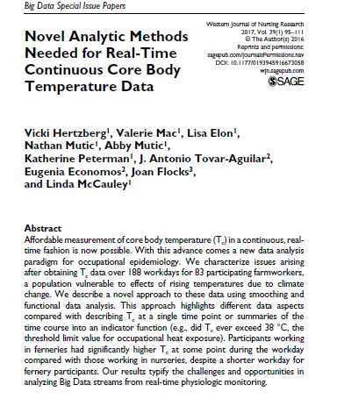
Methods for Analyzing Real-Time Data

Slide 25
Core Temperatures 2015-2017
82% reached 38.0°C
Length of time over 38.0°C
Median= 69 minutes
Range = 1-555 minutes
24% reached 38.5°C
Length of time over
38.5°C
Median= 22 minutes
Range = 1-318 minutes

Slide 26
Heart Rate 2015-2017
% Workers with a Mean Workday Heart Rate (HR) >115 bpm
(35% of Maximum Aerobic Capacity) on ≥1 Study Day

Slide 27
Heat Exposure and Kidney Function

Slide 28
Chronic Kidney Disease of Unknown Etiology (CKDu)
Affecting agricultural workers around the globe
Mainly sugar cane industry
Primarily young men in seemingly good health
Need for dialysis in 30’s and 40’s
> 20,000 premature deaths in Central America alone
California Heat Illness Prevention Study (CHIPS) (n=295)
12% with acute kidney injury over the course of one day at work

Slide 29
Kidney Function: 2015-2016
Biomarker | Before Work¹ | After Work¹ | p value²
Serum Creatinine, mean | 0.70 ± 0.13 | 0.80 ± 0.013 | <.0001
eGFR, mean | 115.2 ± 0.94 | 104.7 ± 0.94 | <.0001
eGFR <90 | 3% | 20% | <.0001
BUN, mean | 14.4 ± 0.29 | 15.8 ± 0.29 | <.0001
Serum Potassium, mean | 4.4 ± 0.02 | 4.2 ± 0.02 | <.0001
Serum Sodium, mean | 141.0 ± 0.11 | 141.2 ± 0.11 | .01
¹n participants for day 1 was n = 248 , day 2 was n = 243, and day 3 was n = 228
²adjusted for random effects due to multiple participants in households and multiple days per participant
Notes:
Pull updated numbers from NIDDK poster

Slide 30
AKI in Girasoles
Presence of AKI:
36% of participants had the criteria indicating AKI on at least one workday
Stages of AKI:
32% had stage 1 AKI on at least one workday
3% had stage 2 AKI on at least one workday
0.4% had stage 3 AKI on at least one workday
The odds of AKI increased 22% for each 5 bpm increase in mean heart rate and 37% for each 5 degree (°F) increase in mean heat index
(KIDIGO Criteria: Increase of post-shift serum creatinine by at least 0.3 mg/dL OR ≥ 1.5 times the pre-shift creatinine)

Slide 31
Analyses/Papers in Progress
Predictors for Heat Stress Symptoms and Core Body Temperatures
Overall Health Status and Work Behaviors as Predictors of Heat Response
Quantifying Occupational Work Intensity and Heat Stress Response
Seasonal Differences in Work Intensity and Heat Stress Response
****Community Translation of Research Findings*****

Slide 32
Next Steps
Pilot testing interventions to reduce heat related illness
Metabolomic analysis of workers with heat exposure
Heat exposure and the microbiome

Slide 33
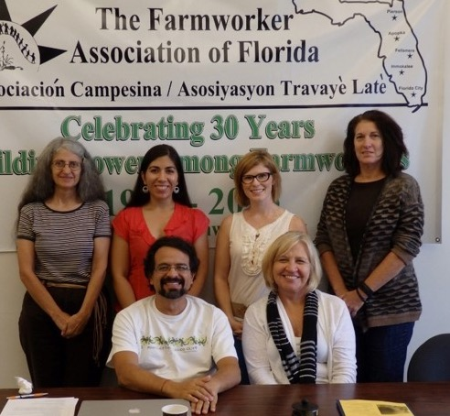
Acknowledgements
Farmworkers Association of Florida
Jeannie Economos
Antonio Tovar-Aguilar, PhD
Nezahualcoyotl Xiuhtecutli, MS
University of Florida
Joan Flocks, JD
Emory University
Roxana Chicas, BSN, RN
Lisa Elon, MS
Vicki Hertzberg, PhD, FASA, P. Stat
Valerie Mac, PhD, RN
Jacqueline Mix, PhD, MPH
Abby Mutic, MSN
Nathan Mutic, MS, MAT, M.Ed
Estefani Ignacio, BS
Funders
NIOSH R01OH010657
NIOSH R21 OH009830-01
SCCAHS

Slide 34

Thank you!

Slide 35
Physiologic Response to Heat: Core Temperature >=38°C Significant Risk Factors:
 | Change in odds of T≥38 |  | 95% CI
Model considered Work Intensity
Per 10 Minutes Mod/Vig Activity | 5% | increase | 2% - 8%
Per 1 unit BMI | 7% | increase | 1% - 13%
Per 5°F Mean Heat Index | 27% | increase | 4% - 56%
Model considered Dehydration
Per .010 Urine Specific Gravity in pm | 47% | increase | 8% - 101%
Per 1 unit BMI | 6% | increase | 1% - 12%
Per 5°F Mean Heat Index | 26% | increase | 3% - 54%

Slide 36
Physiologic Response to Heat: Core Temperature >=38.5°C Significant Risk Factors:
 | Change in odds of T≥38.5 |  | 95% CI
Model considered Work Intensity
Per 10 Minutes Mod/Vig Activity | 4% | increase | 0% - 7%
Per 1 year Working in Agriculture | 8% | decrease | (-13)% - (-3)%
Per 1 unit BMI | 17% | increase | 7% - 27%
Per 5°F Mean Heat Index | 39% | increase | 2% - 89%
Male (compared to Female) | 142% | increase | 20% - 386%
Model considered Dehydration
Dehydration was not a significant predictor of T≥38.5; other results similar

